Slide 1

Merge Sort

Slide 2
On input of n elements:
If n < 2
Return.
Else
Sort left half of elements.
Sort right half of elements.
Merge sorted halves.
Notes:
This is merge sort in pseudocode.
To sort the array, we must sort the left half, sort the right half, and then merge the two sorted halves. But how would we sort the left and right halves? Easy -- just break those subarrays in half as well, sort their respective left and right halves, and merge!

Slide 3
Merge Sort
3
5
2
6
4
1
3
5
2
6
4
1
3
5
2
6
4
1
3
5
2
4
6
1
3
5
2
4
6
1
2
3
5
1
4
6
1
2
3
4
5
6
Notes:
Merge sort is a recursive algorithm for sorting that decomposes the large problem of sorting an array into subproblems that are each a step closer to being solved.
The basic idea is to handle sorting by dividing an unsorted array in two and then sorting the two halves of that array recursively.

Slide 4
sort (int array[], int start, int end)
{
if (end > start)
{
int middle = (start + end) / 2;
sort(array, start, middle);
sort(array, middle + 1, end);
merge(array, start, middle, middle + 1, end);
}
}
Notes:
Here is one implementation of merge sort on an array that identiﬁes the subarrays using pairs of integer indices into the array.

Slide 5
What's the best case runtime of merge sort?
What's the worst case runtime of merge sort?
What's the expected runtime of merge sort?
Notes:
Merge sort requires O(nlog n) time in all cases. Since we divide each set to be sorted in half at each level of recursion, there will be log n levels. Then, at each level, a total of n comparisons must be made in order to merge subarrays. Hence, O(nlog n).
Since the best and worst case runtimes of merge sort are equivalent, the expected runtime is Θ(nlog n).

Slide 6
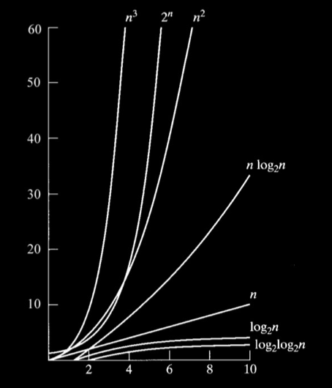
Notes:
O(nlogn) is much more efficient than O(n²), which was the worst case runtime of bubble sort, insertion sort, and selection sort!

Slide 7
Bubble Sort
Selection Sort
Insertion Sort
Merge Sort
O
n²
n²
n²
nlogn
Ω
n
n²
n
nlogn
Θ
n²
nlogn
Notes:
Here's a comparison of the runtimes of merge sort to the runtimes of other sorting algorithms covered in CS50.

